Slide 1
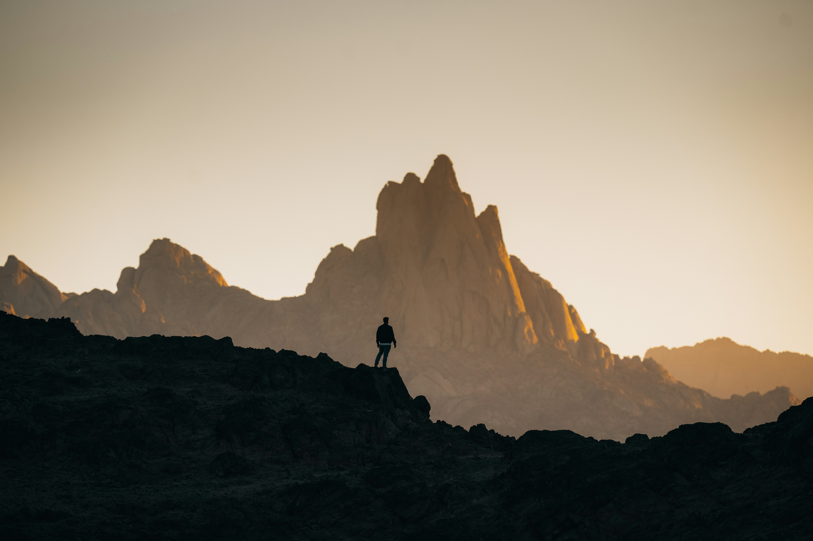
探險的契機
Notes:
https://images.unsplash.com/photo-1682687220742-aba13b6e50ba?q=80&w=2670&auto=format&fit=crop&ixlib=rb-4.0.3&ixid=M3wxMjA3fDB8MHxwaG90by1wYWdlfHx8fGVufDB8fHx8fA%3D%3D

Slide 2
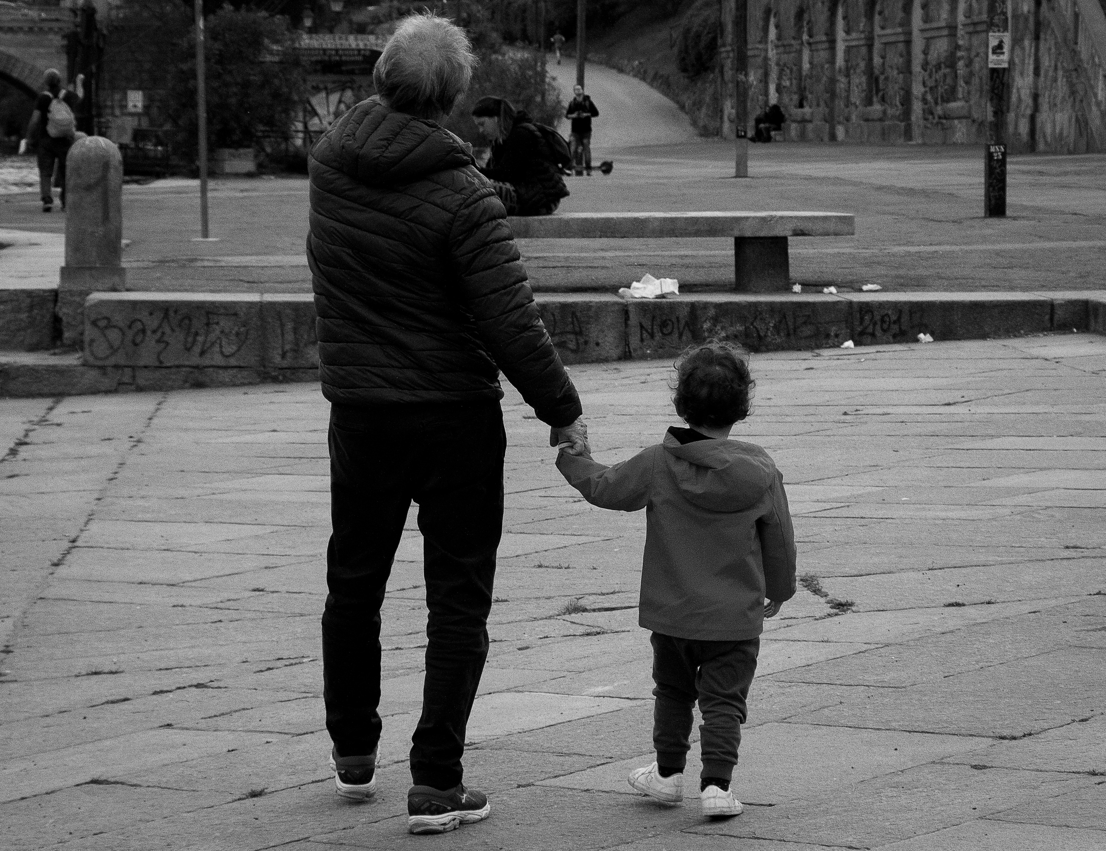
目標：立志長大後一定要成為像祖父那樣的冒險家
Notes:
https://images.unsplash.com/photo-1652085648054-856f46de6198?w=500&auto=format&fit=crop&q=60&ixlib=rb-4.0.3&ixid=M3wxMjA3fDB8MHxzZWFyY2h8MTQxfHxncmFuZHBhcmVudHxlbnwwfHwwfHx8Mg%3D%3D

Slide 3

阻礙：小時候被大人嘲笑是愛做夢的孩子
Notes:
https://unsplash.com/photos/a-person-sitting-on-a-couch-with-a-laptop-X1GZqv-F7Tw

Slide 4
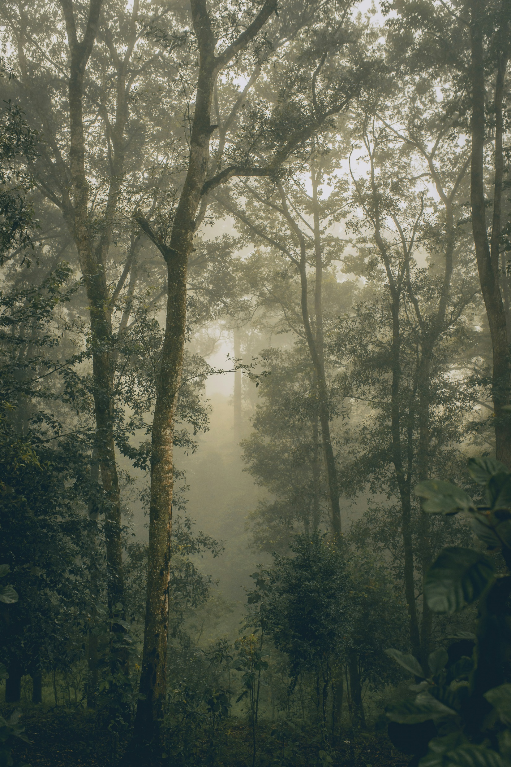
努力：為了要證明自己，訓練自己的基礎生存能力
Notes:
https://images.unsplash.com/photo-1502580969434-4550a9e56735?w=500&auto=format&fit=crop&q=60&ixlib=rb-4.0.3&ixid=M3wxMjA3fDB8MHxzZWFyY2h8OTV8fGZvcmVzdHxlbnwwfHwwfHx8MA%3D%3D

Slide 5
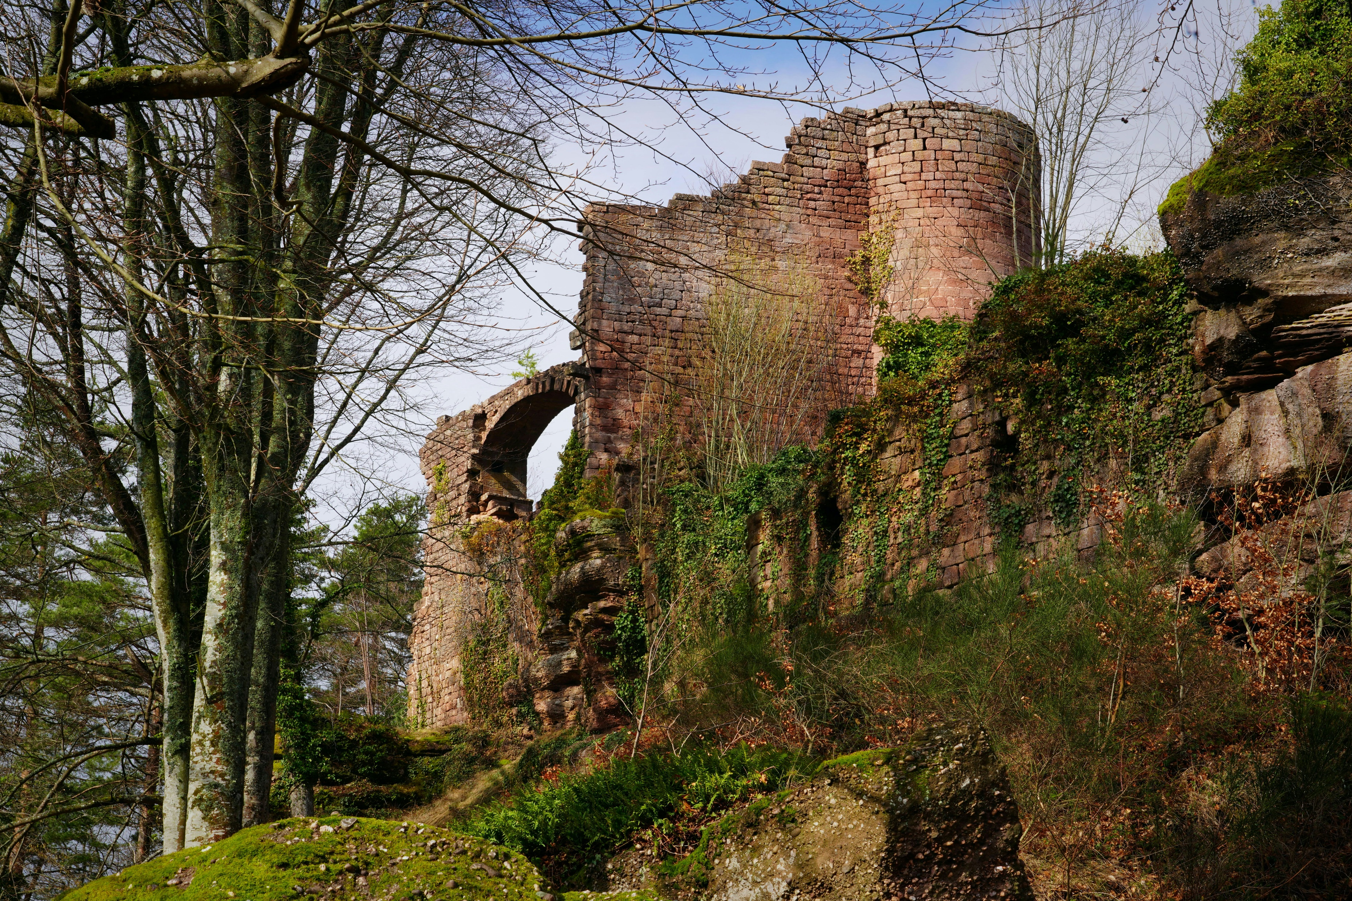
結果：發現了祖父故事中的遺跡
Notes:
https://images.unsplash.com/photo-1710839416553-04fa7cbbeb0c?w=500&auto=format&fit=crop&q=60&ixlib=rb-4.0.3&ixid=M3wxMjA3fDB8MHxzZWFyY2h8NDN8fHJ1aW5zfGVufDB8fDB8fHww

Slide 6
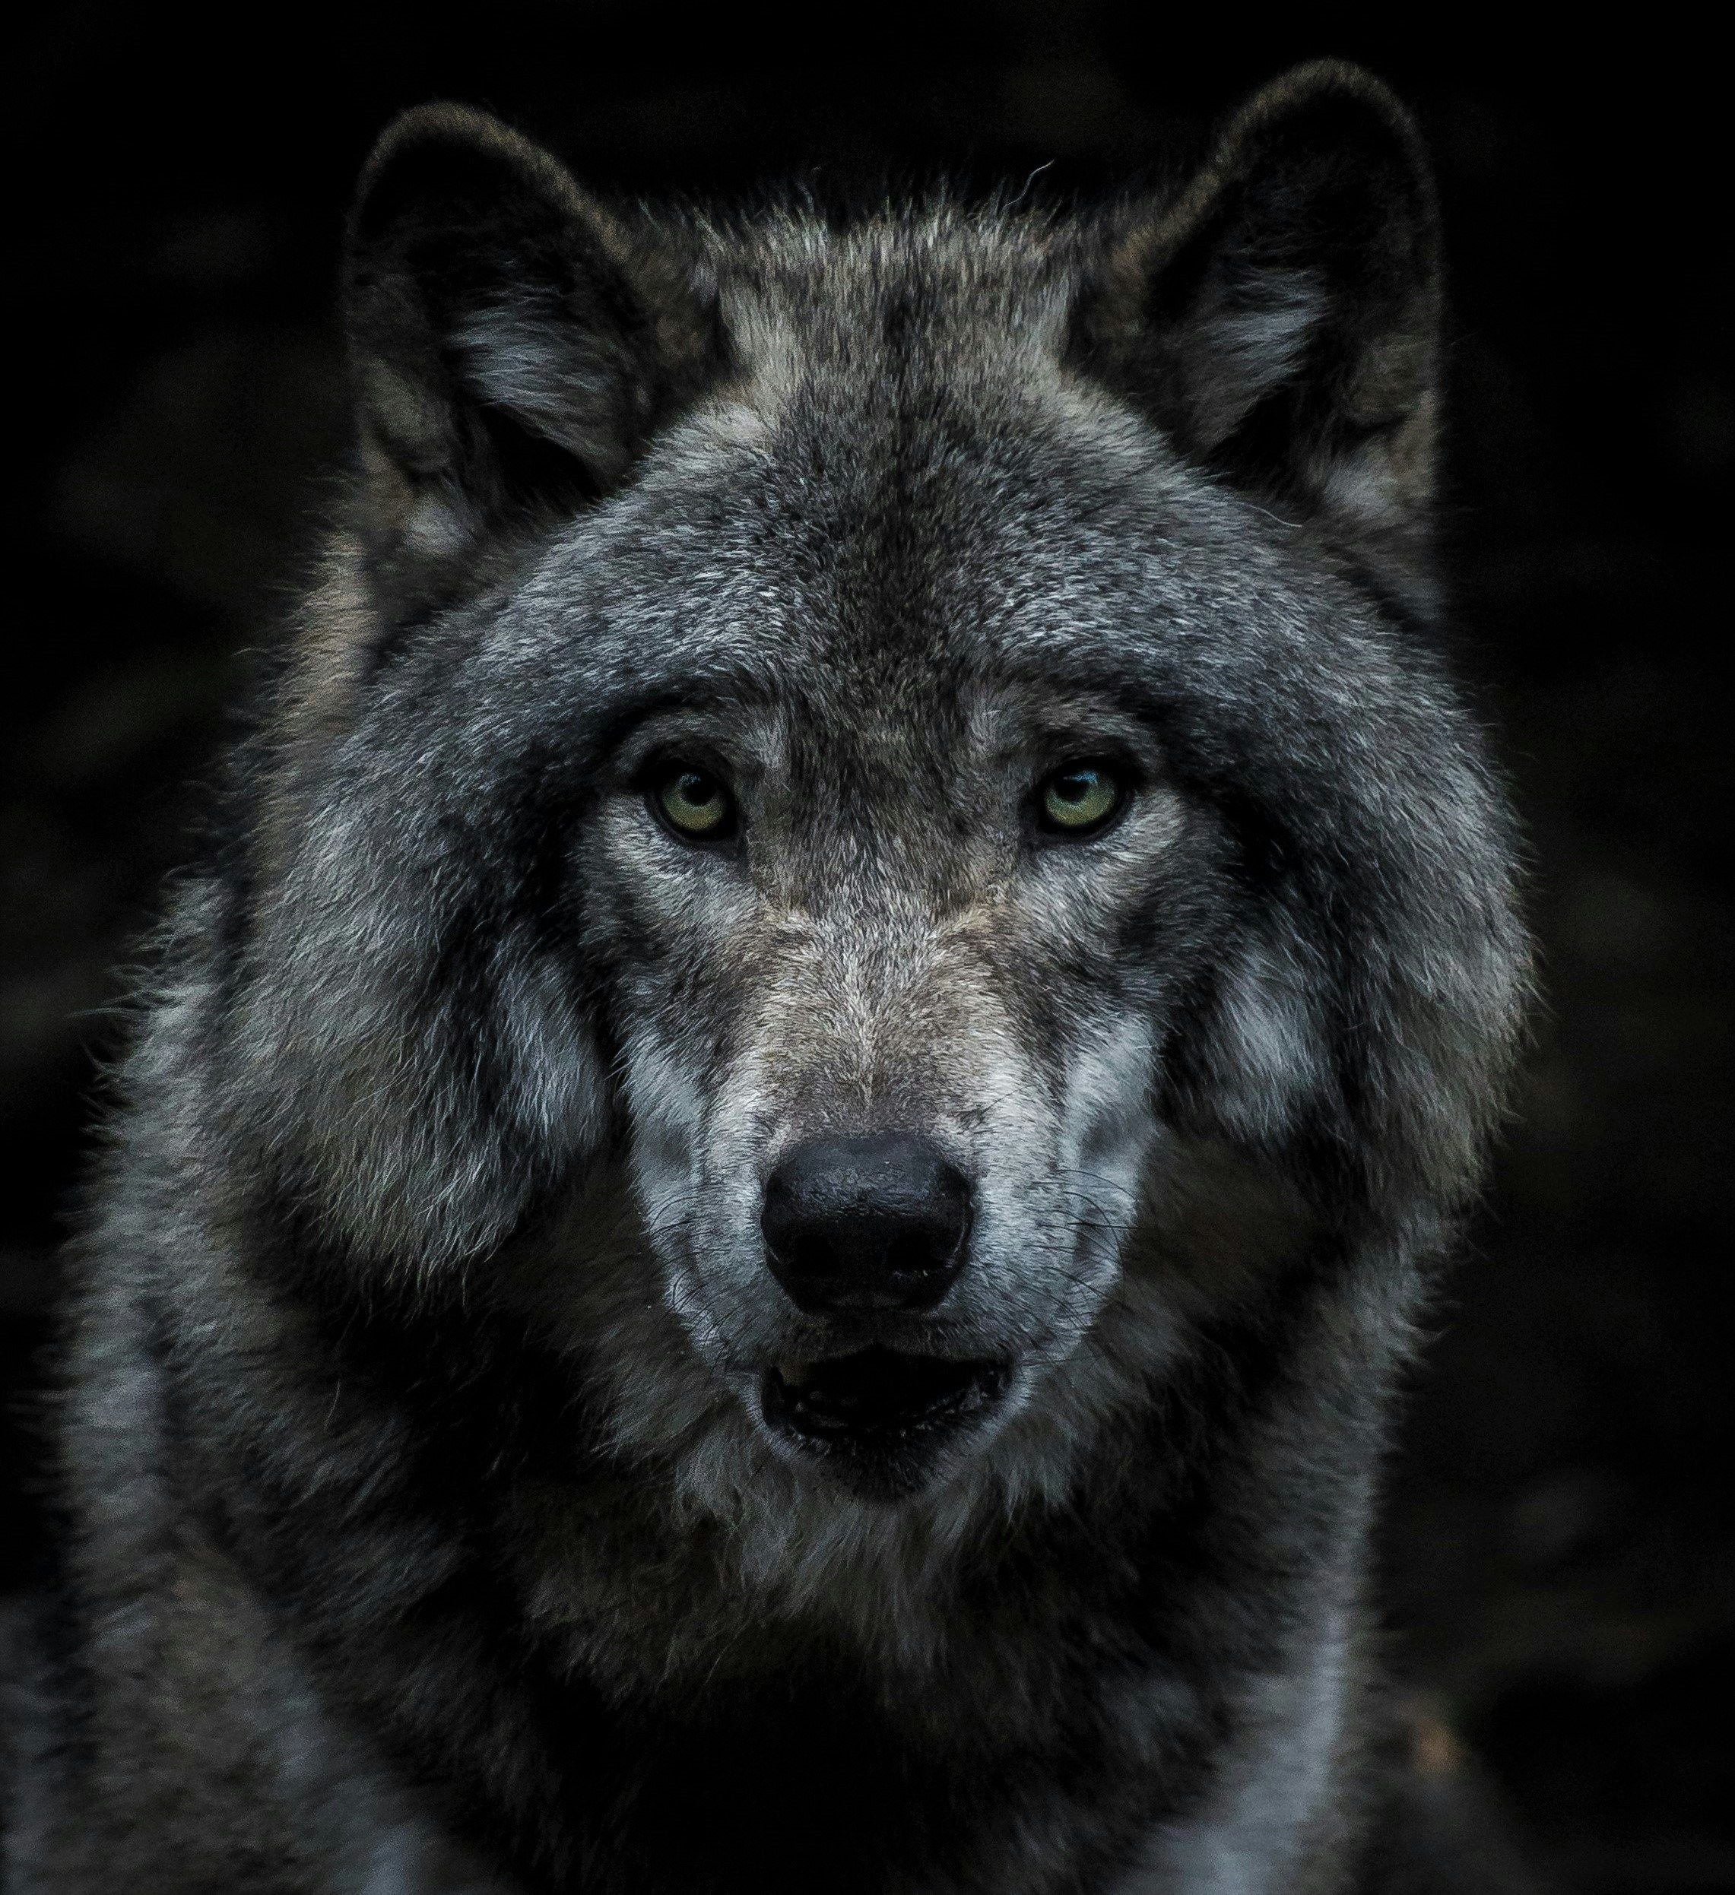

意外：巨大的野狼從陰影中出現，虎視眈眈地盯著我
Notes:
https://images.unsplash.com/photo-1588167056547-c183313da47c?w=500&auto=format&fit=crop&q=60&ixlib=rb-4.0.3&ixid=M3wxMjA3fDB8MHxzZWFyY2h8MTR8fHdvbGZ8ZW58MHx8MHx8fDA%3D https://images.unsplash.com/photo-1583264277139-3d9682e44b03?q=80&w=1287&auto=format&fit=crop&ixlib=rb-4.0.3&ixid=M3wxMjA3fDB8MHxwaG90by1wYWdlfHx8fGVufDB8fHx8fA%3D%3D

Slide 7
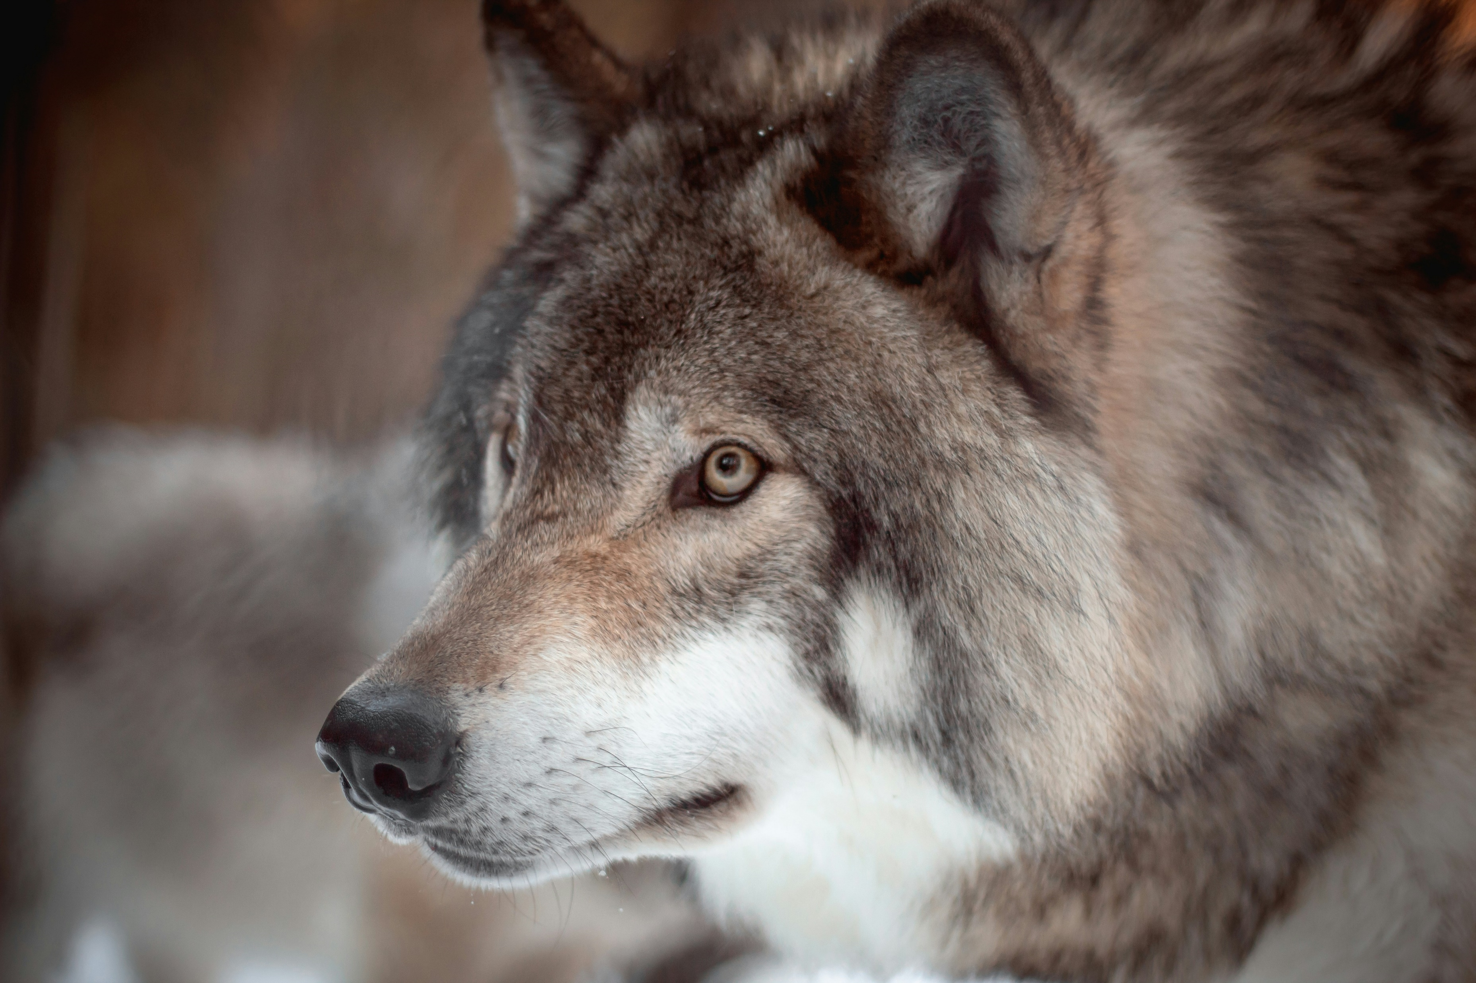
轉彎：分散野狼的注意力，小心翼翼地撤退
Notes:
https://images.unsplash.com/photo-1607350999849-b36c91e0198b?w=500&auto=format&fit=crop&q=60&ixlib=rb-4.0.3&ixid=M3wxMjA3fDB8MHxzZWFyY2h8MTA0fHx3b2xmfGVufDB8fDB8fHww

Slide 8
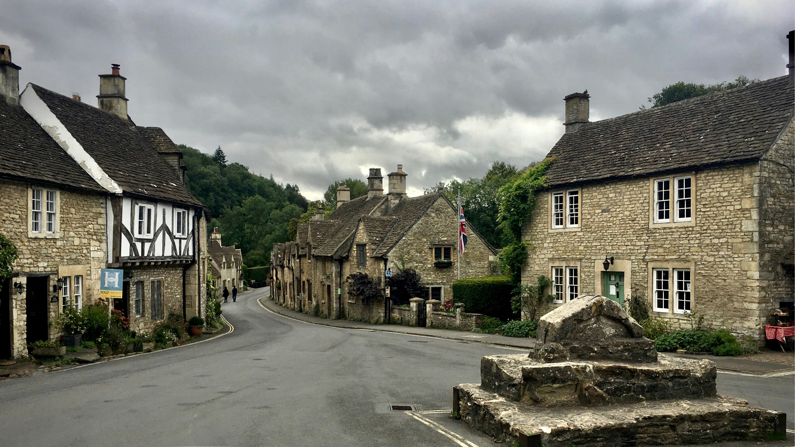
結局：更加堅定了成為一名探險家的決心
Notes:
https://images.unsplash.com/photo-1508325739122-c57a76313bf4?w=500&auto=format&fit=crop&q=60&ixlib=rb-4.0.3&ixid=M3wxMjA3fDB8MHxzZWFyY2h8MTl8fHZpbGxhZ2V8ZW58MHx8MHx8fDA%3D

Slide 9
謝謝大家

